Slide 1

Learning Chef
How to write Recipes on Chef

Slide 2
Presentation Objectives
What is Chef?
Chef Components
What is a Cookbook
Creating “Hello World” cookbook using berkshelf

Slide 3
What is a Chef?
Chef is a powerful automation platform that transforms complex infrastructure into code, bringing your servers and services to life.

Slide 4
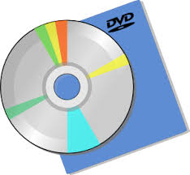

Node Preparation
Install Software
Server
Server
Server
Server
Configure Software
Repetitive Task

Slide 5
Node Preparation
Complexity Increases as the Infrastructure Scales out

Slide 6





Chef Components
Download Recipes & Configuration
Target Node
Manage Nodes, Cookbook, Roles
Node Bootstrapping

Slide 7














Chef Components
Download Recipes & Configuration
Target Node
Manage Nodes, Cookbook, Roles
Node Bootstrapping

Slide 8
Chef Components
Download Recipes & Configuration
Manage Nodes, Cookbook, Roles
Node Bootstrapping

Slide 9
Chef-client
Chef-Client
Build Node
Authentication
Converge
Load Cookbooks
Sync cookbooks
Node.save
success?
Notification Handler
Yes
No
Exception

Slide 10
Authentication
/etc/chef/client.pem?
No
/etc/chef/validation.pem?
No
401
Yes
Yes
Request API Client
Sign Request
Client.pem

Slide 11
What is a Cookbook?
A cookbook is like a “package” for Chef recipes.
It contains all the recipes, files, templates, libraries etc, required to configure a portion of your infrastructure
Typically they map 1:1 to a piece of software or functionality
Cookbook
README.md
attributes
definitions
files
default
libraries
metadata.rb
providers
recipes
default.rb
resources
templates
default

Slide 12
What is a Resource
A resource is a statement of configuration policy that:
Describes the desired state for an item
Declares the steps needed to bring that item to the desired state
Specifies a resource type—such as package, template, or service
Lists additional details (also known as attributes), if necessary
Tells the chef-client which action to take

Slide 13
Common Used Resources
Resource Name | Purpose
package | To install, upgrade or remove a package
service | To manage service state on a node i.e. enable, disable, reload, start, stop
file | to manage files directly on a node. Permitted actions create, create_if_missing, delete or touch
template | This resource is used to create a file based on a template (.erb). Based on logic and placed holder variables a file is generated on runtime ad saved on the desired location on a node. Same actions available as file
directory | To manage directory resource, which is a hierarchy of folders. Actions available are create or delete
execute | To execute a single command on the node (similar to running from terminal window on a machine)
remote_directory | To incrementally transfer a directory from a cookbook to a node
remote_file | To transfer a file from a remote location using file specificity

Slide 14
Example of Using Chef
The Problem: We need a web server configured to server up our home page.
Success Criteria: We can wee the homepage in a web browser

Slide 15
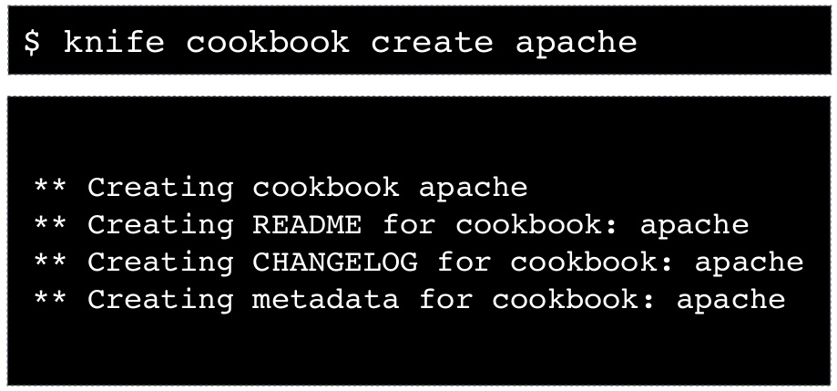
Creating a Cookbook

Slide 16
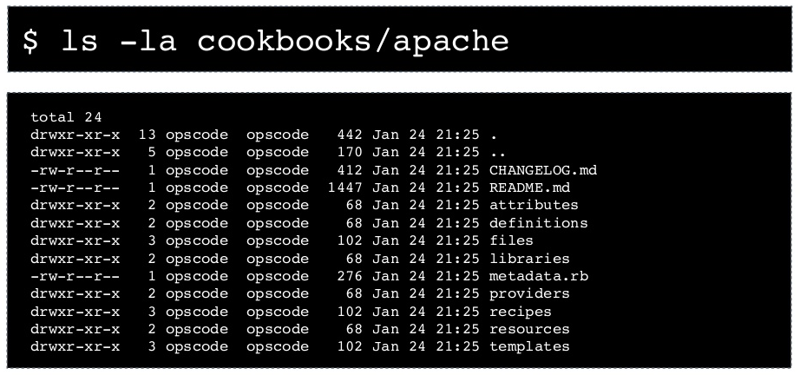
Creating a Cookbook

Slide 17
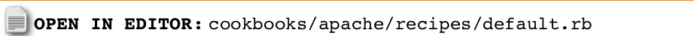
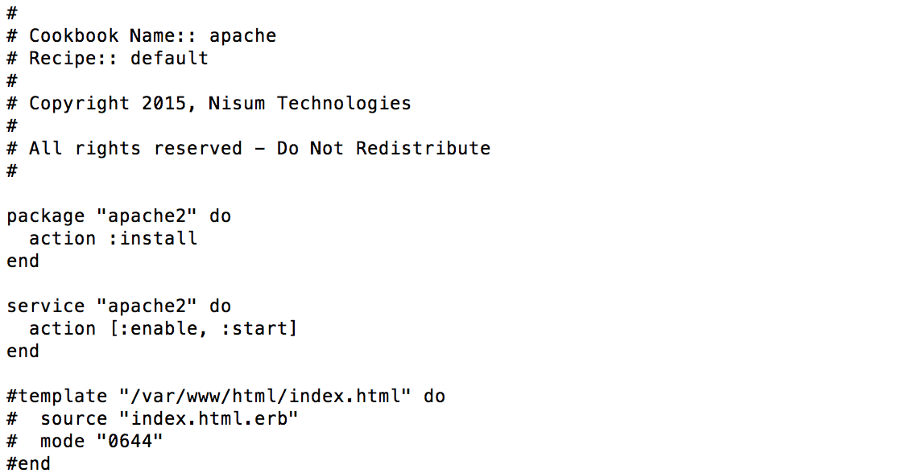
Writing a Recipe

Slide 18
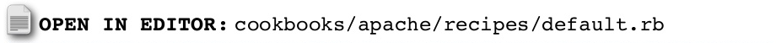
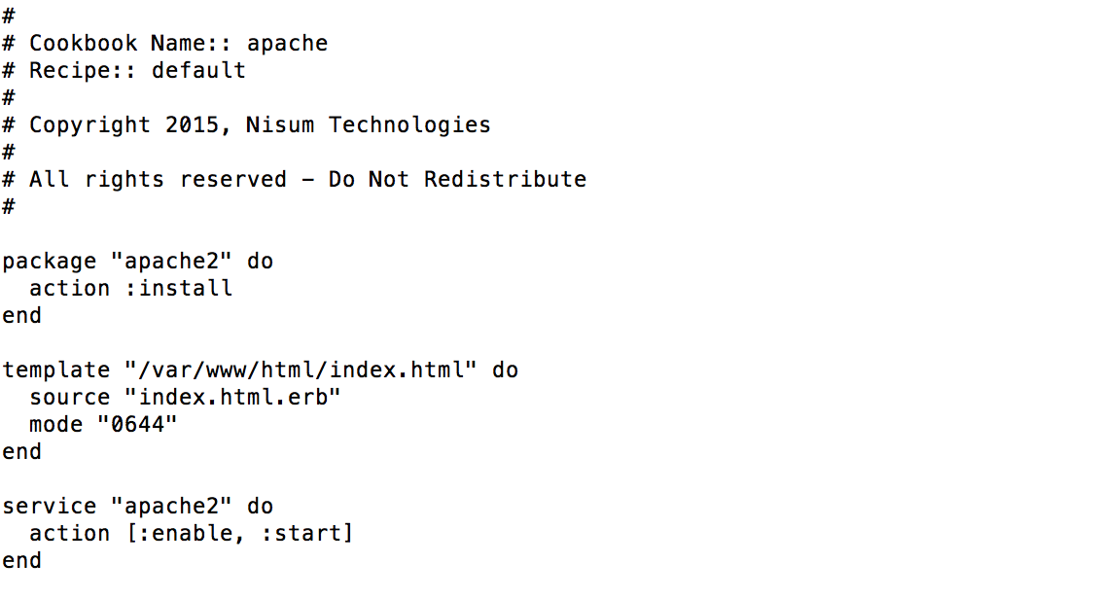
Adding a Package Resource
Using a Package Resource
1
Name of the Resource
2
Action to Perform
3

Slide 19
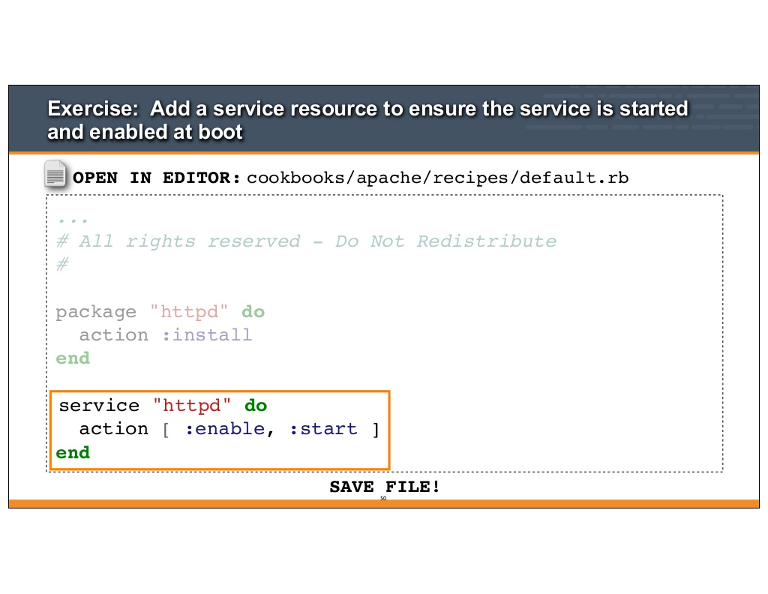
Adding a Template Resource
Using a template Resource
1
Target file name
2
Template file name
3
Template file permission
4

Slide 20
Adding a Service Resource
Using a Service Resource
1
Name of the Resource
2
Actions to Perform
3

Slide 21
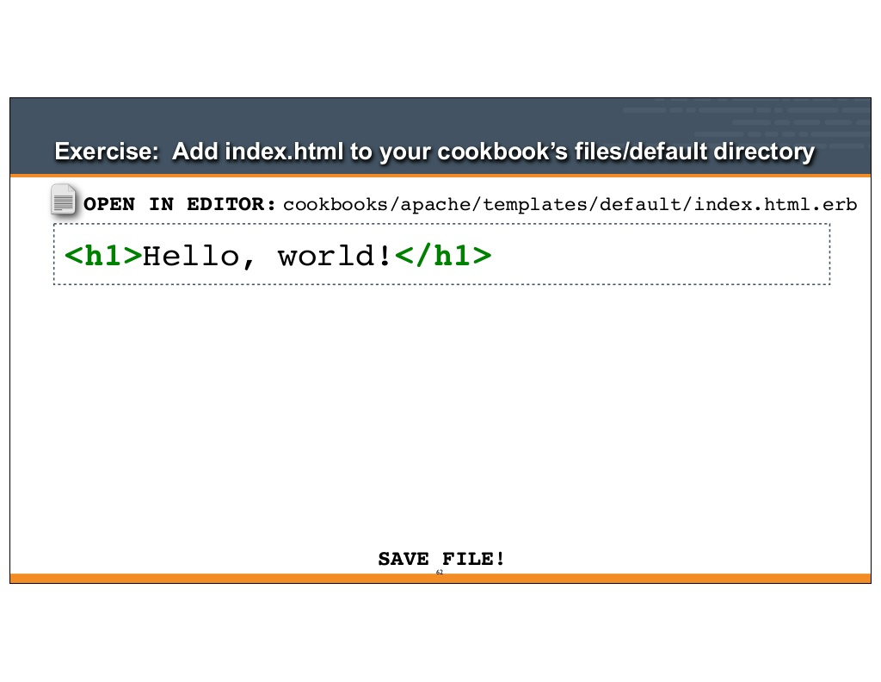
Create Template File
/attributes/default.rb

Slide 22
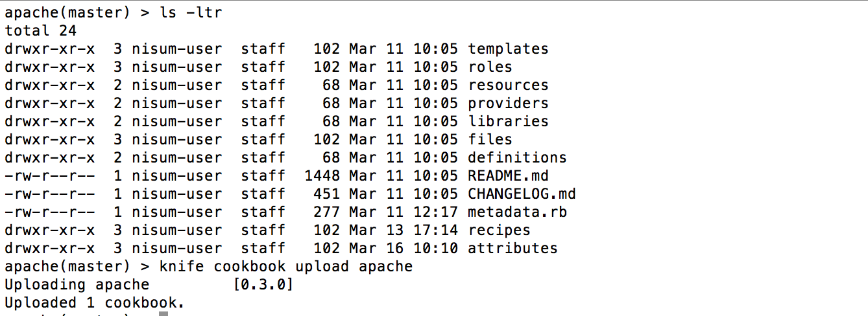
Upload Cookbook
1

Slide 23
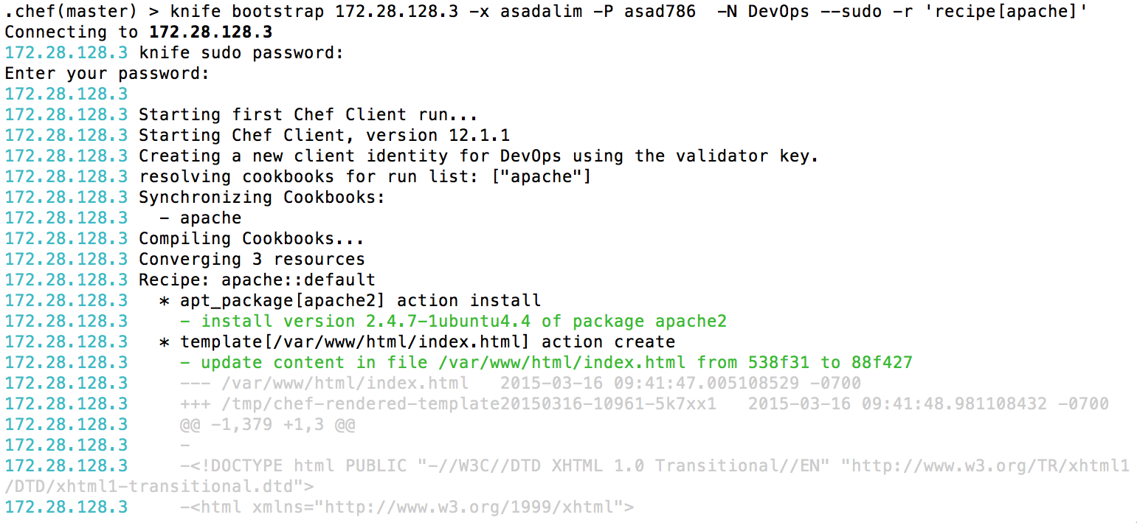
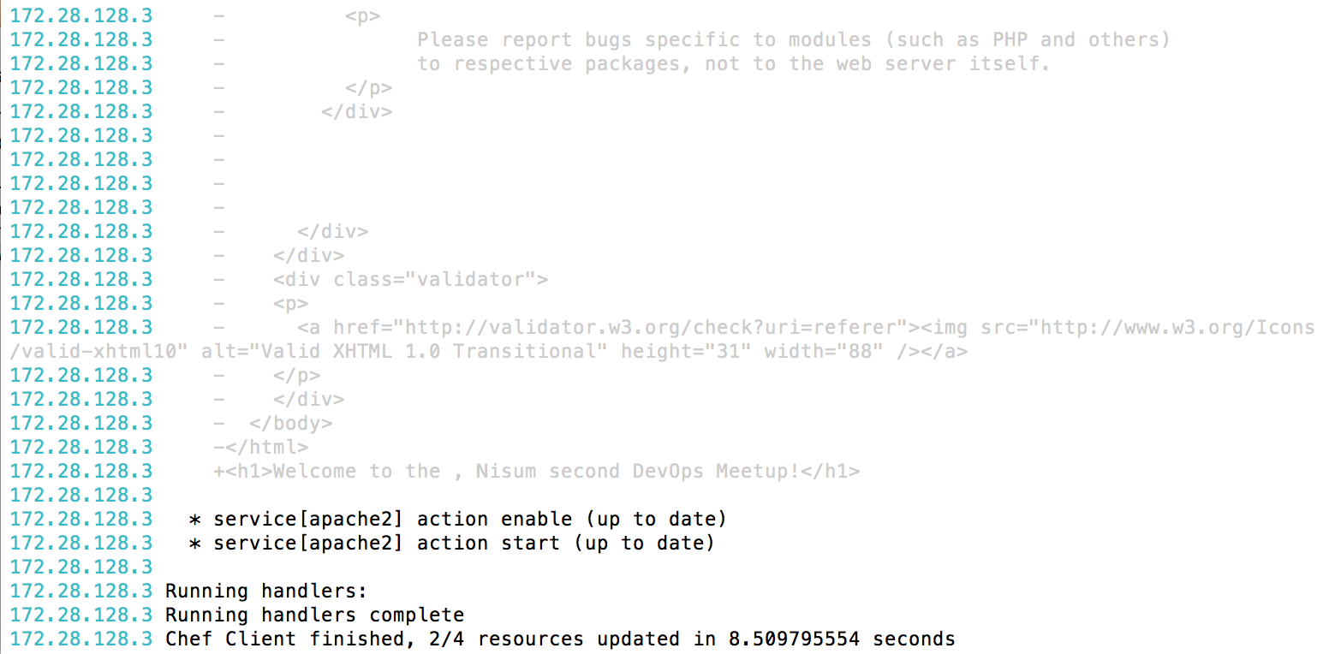
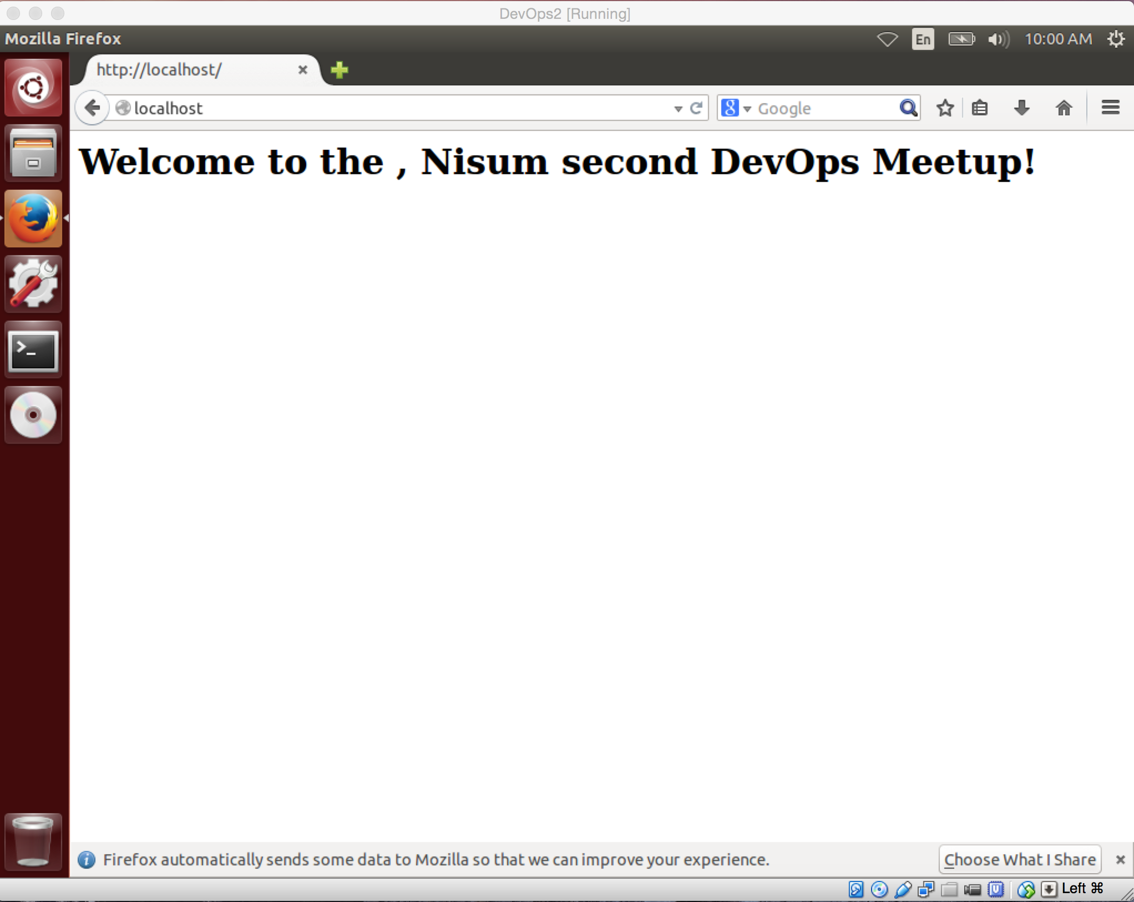
Bootstrap Node
*****
*****

Slide 24
Demo

Slide 25
References
Overview of Chef
(https://learn.chef.io/fundamentals-series/week-1/)
Chef Fundamental Training Series Module 3
(http://www.slideshare.net/opscode/week-3-setup-node-and-write-cookbook?related=3)

Slide 26
Thank You

